Slide 1

Ethereum & Solidity
Deryck Gebe & Mark Conrad

Slide 2
Table of Contents
Ethereum
Solidity
Function Types
Variable Types
Example Contract
Remix
Assignment

Slide 3

Ethereum
A world-wide network of computers
Known as nodes
Ethereum Virtual Machine (EVM)
The EVM processes transactions on the network
Executes the code within smart contracts
Ether is the native currency
Ether is used to send money

Slide 4
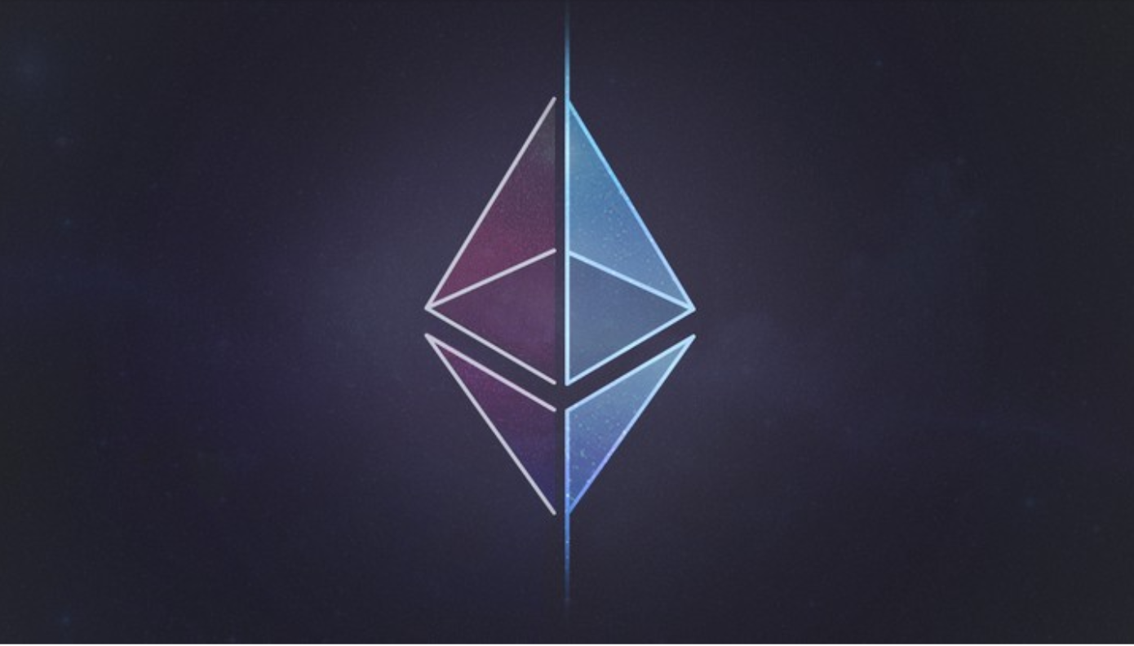
Ethereum
Transactions cost money
Users pay for computation
This is called gas
Need efficient code
Inefficient code = More computation = More money
Average transaction cost is 15 cents!

Slide 5
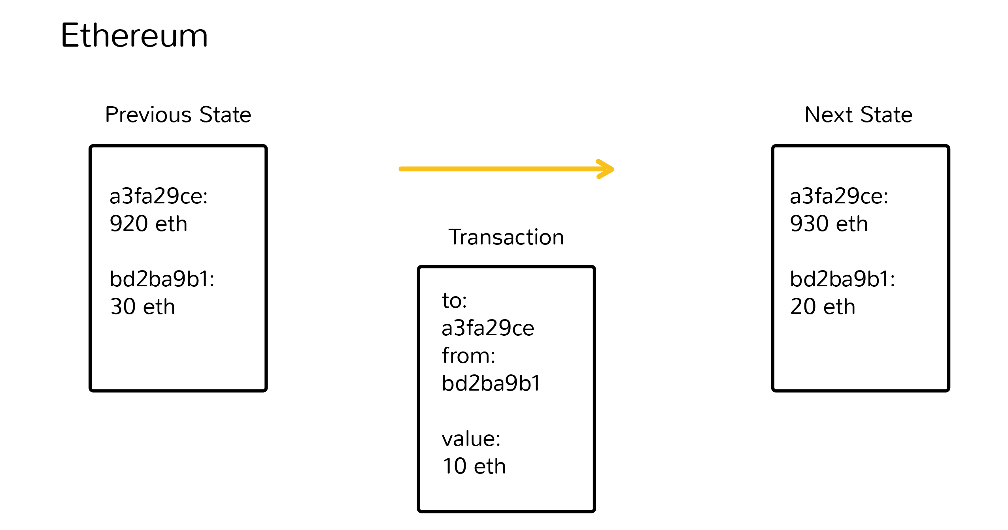
Ethereum
The Ethereum blockchain holds all contracts and associated data
This is called state
State is updated when new blocks are added to the blockchain
https://www.coindesk.com/information/how-ethereum-works/

Slide 6

Solidity
Created to work with the EVM
contract-oriented language
Influenced by JavaScript, C++, and Python
Statically typed language
.sol file extension

Slide 7
Function types
function name() types
public
anyone can call it
private
can only be called within the contract
view
returns data, does not modify any data
payable
send Ether when calling
returns (varType)
Many more built in functions!
Cannot return data from functions that modify data

Slide 8
Variable types
address
holds an Ethereum address
array
bool
fixed or ufixed
not fully supported by Solidity (yet)
int or uint
uint can only be positive
mapping
string

Slide 9
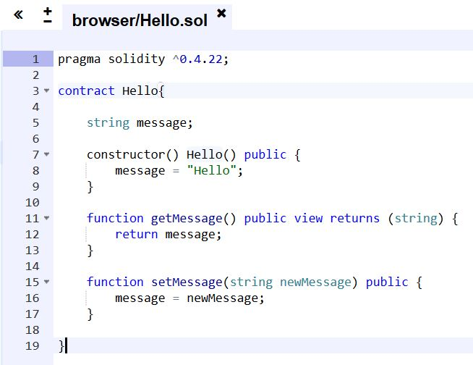
Example contract
This contract is stored on the Ethereum blockchain.
When I call getMessage()
Node would receive that transaction (call)
EVM runs the function and returns the message
Class
Constructor
Getter
Setter

Slide 10
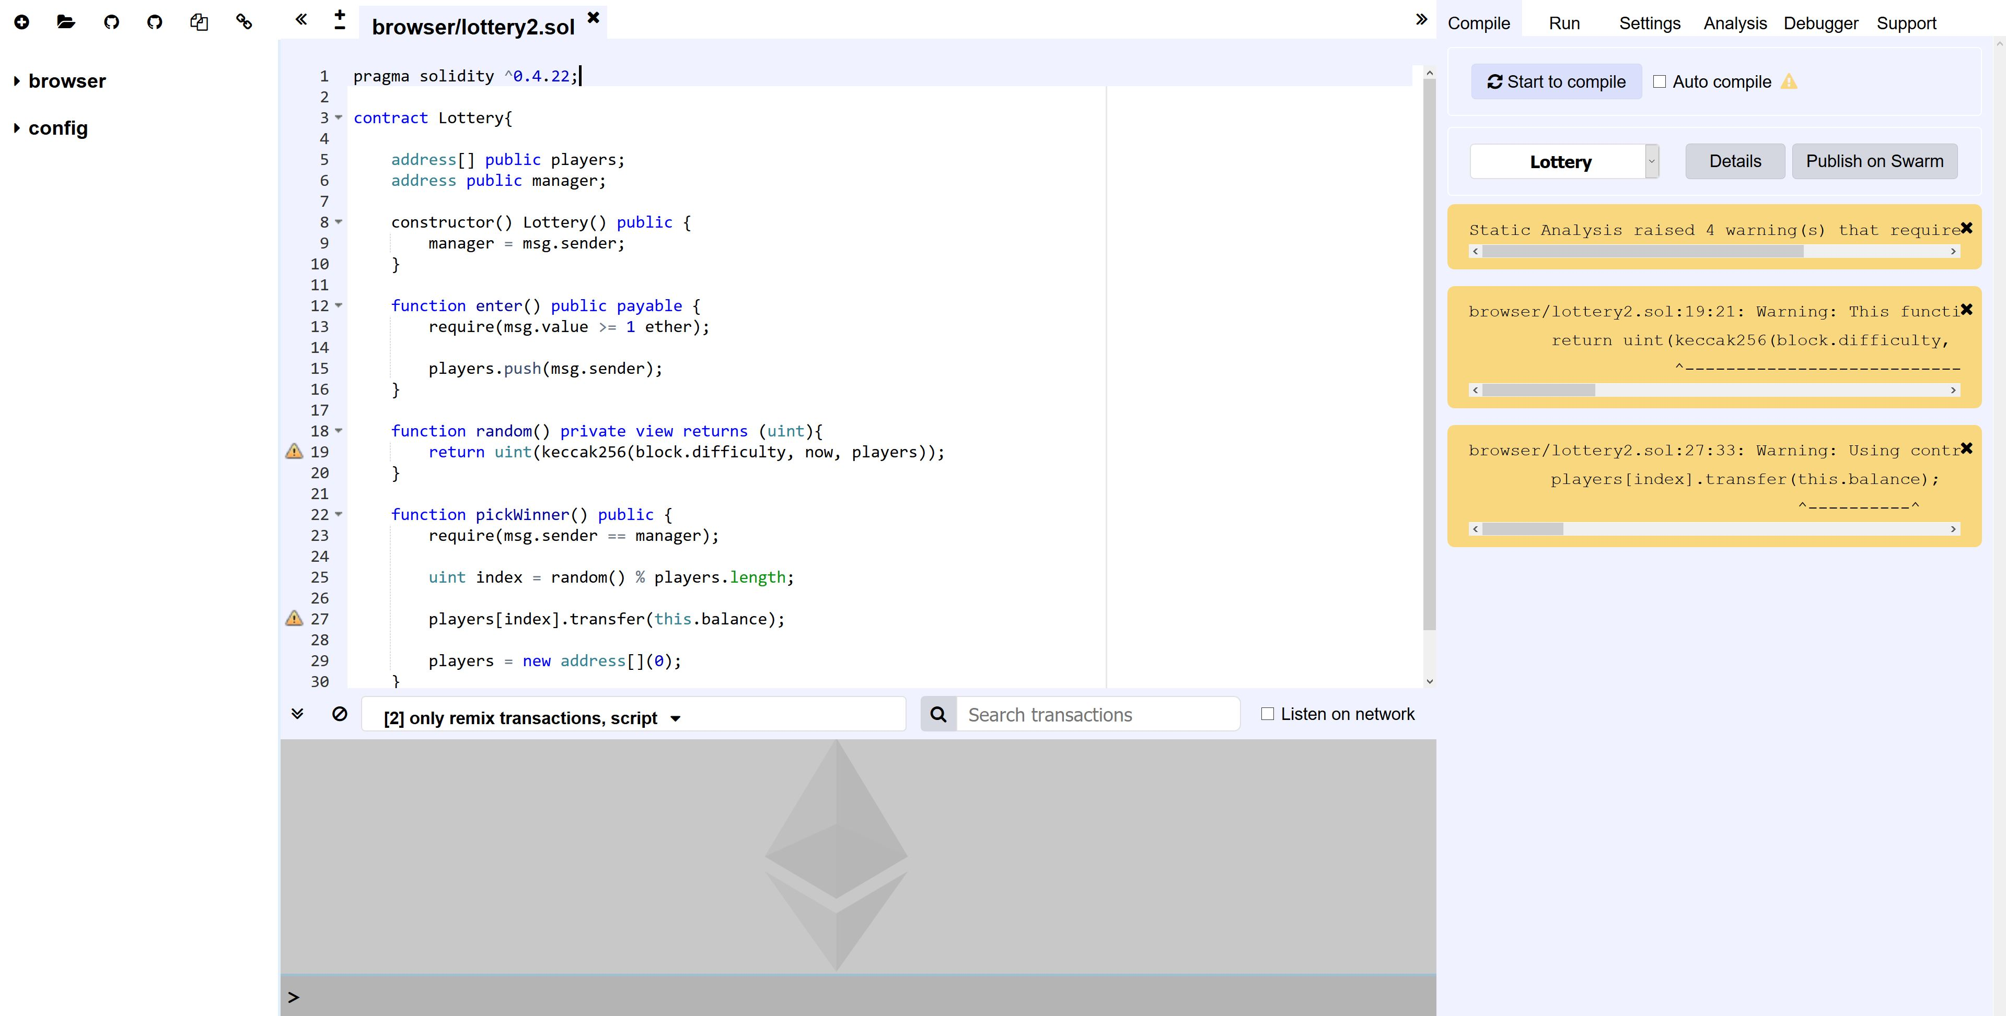
https://remix.ethereum.org
This is the Remix IDE

Slide 11
Summary
Ethereum is a worldwide network of computers
These nodes execute smart contracts
Users must pay for computation
Solidity is the native language to make smart contracts

Slide 12
Assignment
Make a lottery smart contract
Objective: Players will send ether to the smart contract
This ether is the prize pool
A winner will be chosen when the ‘manager’ calls a function

Slide 13
Assignment
Requirements:
A way to keep track of players
Force players to send ether when they join
Have a contract manager
A function to randomly pick a winner

Slide 14
Let’s start
Good luck, have fun!
Ask questions
In-browser IDE
https://remix.ethereum.org
Assignment PDF
https://goo.gl/bZBbRg

Slide 15
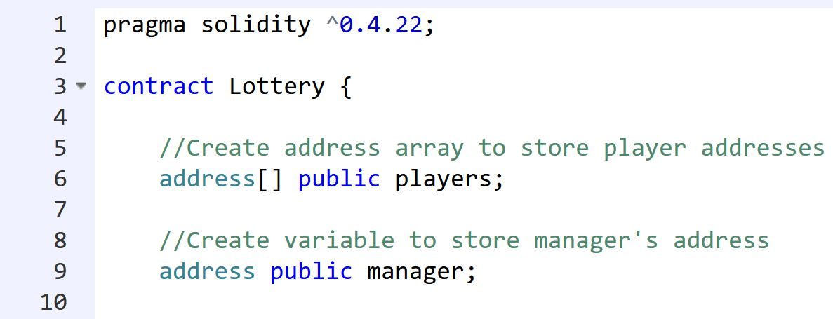
Line 1 tells the compiler what version of Solidity we are using.
Line 3 creates the contract, like a class.
Line 6 creates a dynamic address array.
Line 9 creates an address variable for the contract manager.

Slide 16
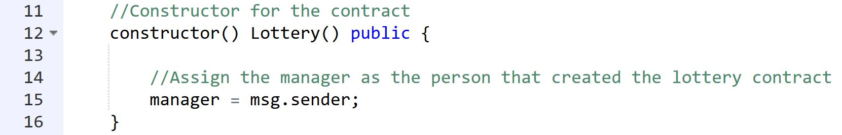
Line 12 is the contract’s constructor function.
Line 15 assigns the contract creator as the manager
msg.sender is whoever sent the transaction
Creating a contract requires a transaction

Slide 17
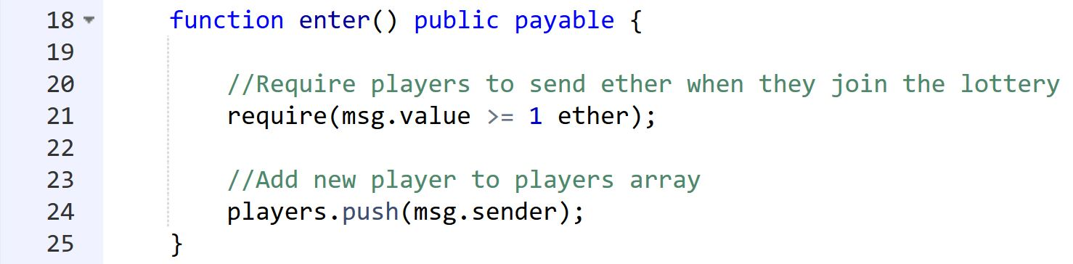
Line 12 is the contract’s constructor function.
Line 15 assigns the contract creator as the manager
msg.sender is whoever sent the transaction
Creating a contract requires a transaction

Slide 18
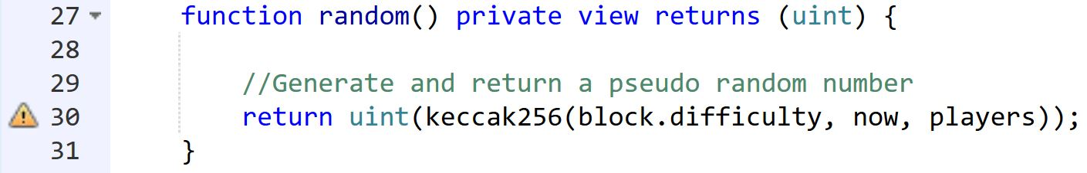
Line 27 declares the pseudo random number function
This is a simple and predictable random number generation
Do not use this when working with real value
Line 30 returns a pseudo random number
Keccak256 is a hash function
block.difficulty is a property of the blockchain
now is the time
Players is the array of addresses

Slide 19
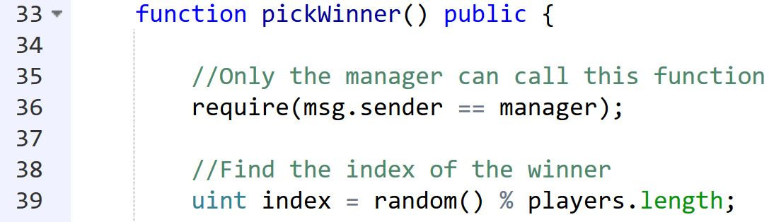
Line 36 requires that the person (account) calling the pickWinner() function is the manager
Line 39 gets the array index of the winning player
Pseudo random number modulo the length of the players array
This will produce an index within the length of the players array
This index corresponds to the winning address

Slide 20
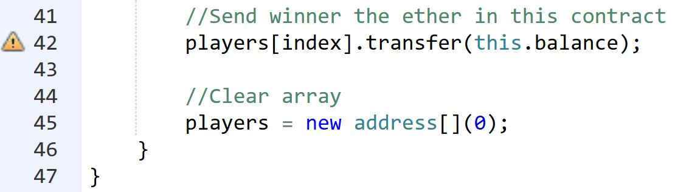
Line 42 sends the winning player the balance (amount) of ether in the lottery contract
Line 45 clears the players array
The contract is now ready for another lottery
The (0) is there to set the array with initial length of 0

Slide 21
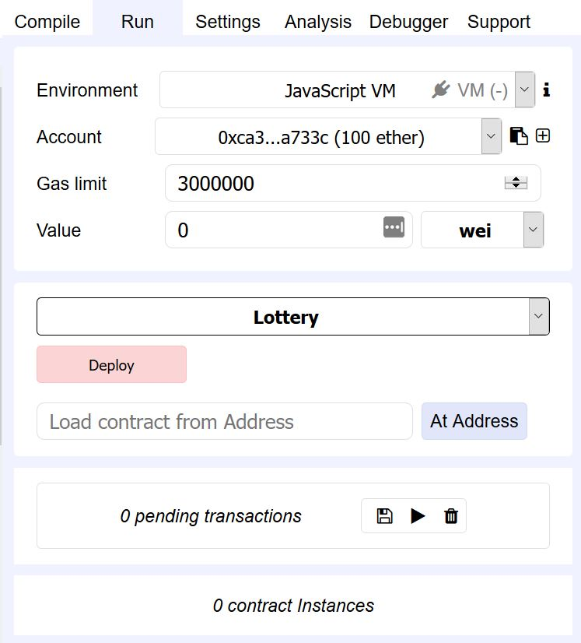
Click deploy to activate the contract!

Slide 22
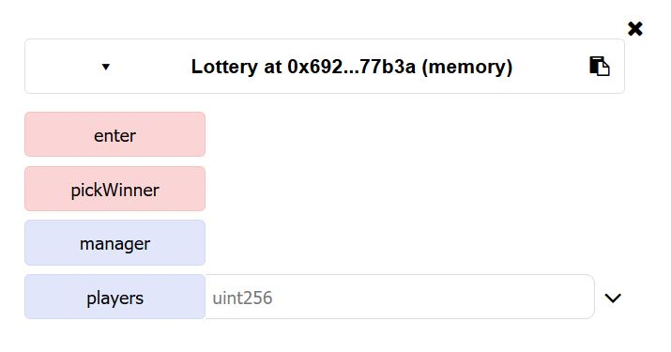
The two public functions in the contract.
The two public, contract level variables in the contract.

Slide 23
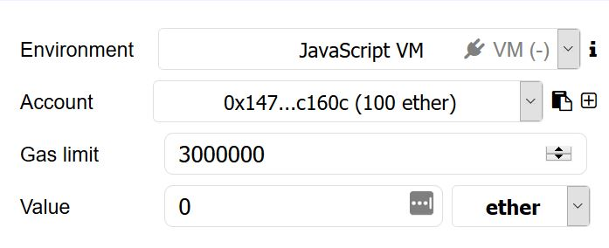
Five accounts, each has 100 ether.
Change this to ether. Try joining the lottery.

Slide 24
Testing
Join the lottery with several accounts.
Try joining without the required amount of ether
Try picking a winner from an account other than the manager
Remember: the manager is the account that created the contract

Slide 25

Congratulations!

